Slide 1

NYC Airbnb Recommendations
Pranay Bhandare

Slide 2
Introduction
The idea of this study is to help people planning vacations in NYC to choose an Airbnb listing based on a criterion of preferences for entertainment, food and other factors. I will analyze Manhattan listings to recommend an area that best suits the criterion of preferences while considering price and location. I am trying to pinpoint the most happening venues around Airbnb listings to understand what locals from that area are into and what possible events they can attend to get a taste of the culture and vibes in a potential vacation spot.

Slide 3
Data Sources
Kaggle Airbnb Dataset: https://www.kaggle.com/dgomonov/new-york-city-airbnb-open-data
Foursquare Api
Extract venues in Manhattan and Brooklyn neighborhoods
I have utilized python to conduct a cluster analysis to recommend listings.

Slide 4
Requirements
Price range = $100 - $200
Entertainment venues:
Variety of cuisines
Shopping
Dessert shops
Coffee shops
Trustworth Airbnb tenants
This was defined as listings with greater than 10 reviews

Slide 5
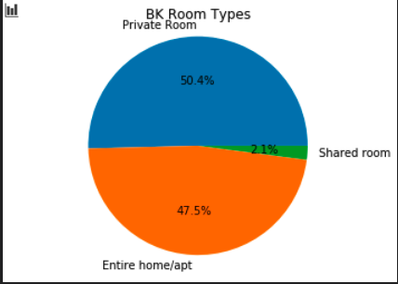
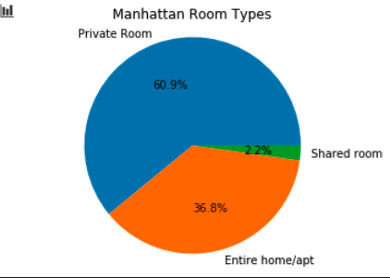
Exploratory Data Analysis
Notes:
BK versus Manhattan room types

Slide 6
Exploratory Data Analysis (cont.)
Manhattan average Airbnb = $197 & Brooklyn average Airbnb = $127
Manhattan is more expensive than Brooklyn
Found that Chelsea, Greenwich Village, Williamsburg, Kensington are the neighborhoods that have the most diverse food
Abundance of shopping and coffee shops as well
Chelsea has the most listings of Airbnb’s between $100 - $150

Slide 7
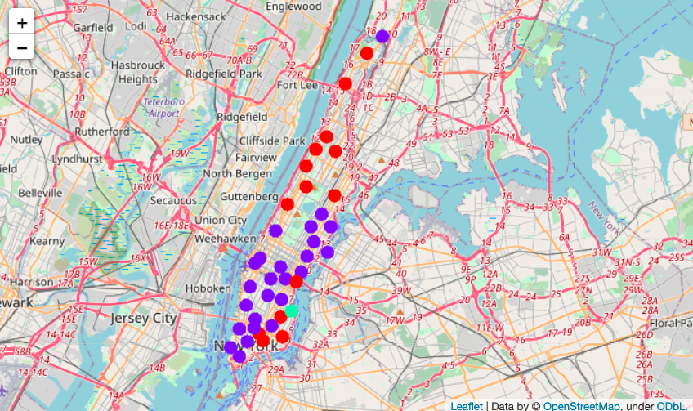
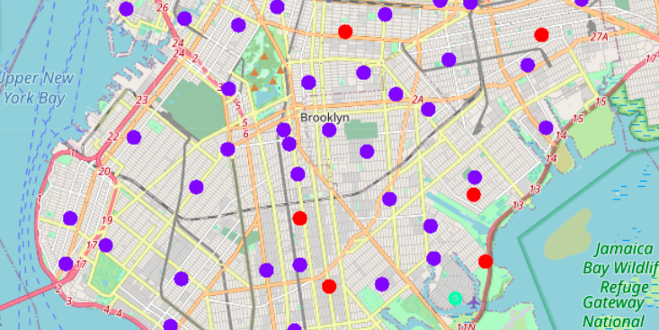
K-Means Clustering
Notes:
Left: Manhattan one hot encoding that shows airbnb listings in clusters based on frequency of coffee shops and restaurants; more variety
Right: BK one hot encoding that shows airbnb listings in clusters based on frequency of coffee shops and restaurants
Purple = restaurants
Red = coffee shops
Light blue = shopping

Slide 8
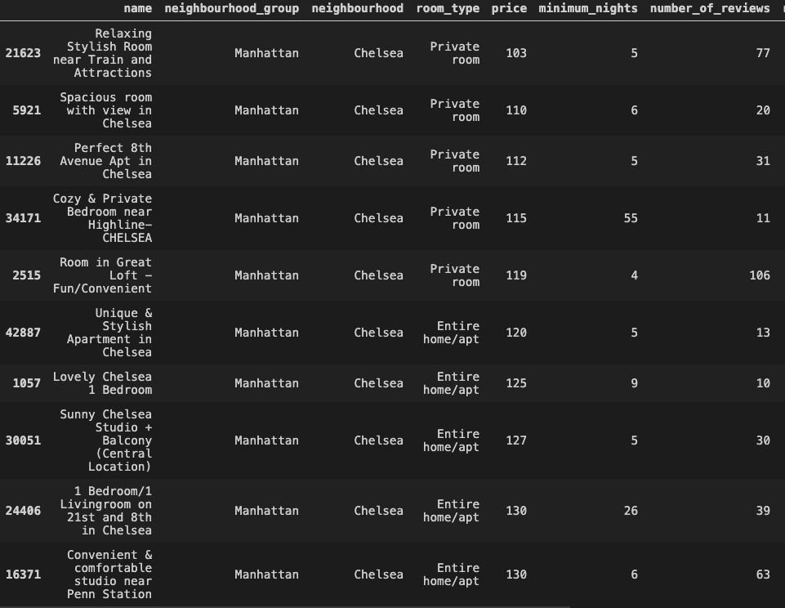
Recommendations
Recommended the ten cheapest airbnb listings in each neighborhood
Chelsea had the most unique listings that met the requirements of the stakeholder.

